Slide 1
Ergogenic Aids

Slide 2
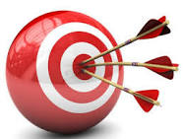
Objectives
Define ergogenic aids and recognize their mechanisms of action in the body
Recognize the side effects of anabolic steroid use and list the specific side effects in men and women
Describe how caffeine works as an ergogenic aid
Compare and contrast the use and side effects of other ergogenic aids which include glutamine, human growth hormone, amphetamines, DHEA, ephedrine, and alcohol

Slide 3
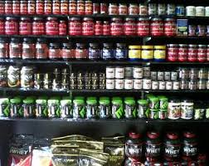
Ergogenic Aids
Did you know?
Sports supplements are the largest segment of the dietary supplement industry
Indiscriminate use increase the likelihood of adverse side effects
Many fail to conform to labeling requirements
Notes:
Ergogenic refers to the application of a nutritional, physical, mechanical, psychological, physiologic, or pharmacologic procedure or aid to improve exercise capacity, athletic performance, and responsiveness to training.

Slide 4
How Do Ergogenic Aids Work?
Definition: A technique or substance used for the purpose of enhancing performance
Act as central or peripheral nervous system stimulant
Act as a supplemental fuel source
Reduce or neutralize performance-inhibiting metabolic byproducts
Facilitate recovery

Slide 5
Anabolic Steroids
Used to treat natural androgen deficiency, muscle-wasting diseases, osteoporosis, severe breast cancer, and decline in LBM due to age, HIV, or kidney disease
Used by some athletes along with stimulants, hormones, and diuretics
Many athletes are screen for steroid use

Slide 6
Structure and Action of Anabolic Steroids
Similar to the hormone testosterone
Steroid use combines with resistance training and protein intake to improve strength, speed, and power
Increased use among young athletes

Slide 7

Side Effects from Anabolic Steroid Use
Connective tissue damage
Chronic stimulation of the prostate gland
Possible kidney malfunction
Injury to and alterations in cardiovascular function
Impaired cardiac microvascular adaptation to exercise training

Slide 8
Specific Anabolic Steroid Side Effects in Men
Infertility
Reduced sperm concentrations
Decreased testicular volume
Gynecomastia
Chronic stimulation of the prostate gland
Alteration in cardiovascular function
Increased blood platelet aggregation
Increased risk of stroke and acute MI
Notes:
Gynecomastia: excessive development of the male mammary glands, sometimes secreting milk

Slide 9
Specific Anabolic Steroid Side Effects in Women
Deepened voice
Increased facial and body hair
Altered menstrual function
Dramatic increased in size of sebaceous gland
Acne
Decreased breast size
Long-term effects of steroid use on reproductive function ?

Slide 10

ACSM Position on the Use of Anabolic Steroids
“The use of anabolic-androgenic steroids by athletes is contrary to the rules and ethical principles of athletic competition as set forth by many of the sports governing bodies.”
“ACSM supports these ethical principles and deplores the use of anabolic-androgenic steroids by athletes.”

Slide 11
Human Growth Hormone (GH)
AKA somatotropin
Stimulates bone and cartilage growth, enhances fatty acid oxidation, and slows glucose and amino acid breakdown
Side effects:
Swollen feet and ankles, joint pain, carpal tunnel syndrome, and development of a diabetic or prediabetic condition
Gigantism and acromegaly
Notes:
Excessive GH production during the growth period produces gigantism, an endocrine and metabolic disorder that triggers abnormal size or overgrowth of the entire body or any of its parts.
Excessive GH production following cessation of growth produces the irreversible disorder acromegaly. Enlarged hands, feet, and facial features characterize this malady.

Slide 12
Dehydroepiandrosterone (DHEA)
A relatively weak steroid hormone
Synthesized from cholesterol
Largest concentrations in the brain
Because it occurs naturally, the FDA has no control over its distribution or claims
Some believe supplementing with DHEA blunts the negative effects of aging
Notes:
DHEA chemical structure closely resembles that of the sex hormones testosterone and estrogen.
Despite its quantitative significance as a hormone, researchers know little about DHEA.
The appropriate DHEA dosage for humans has not been determined.

Slide 13
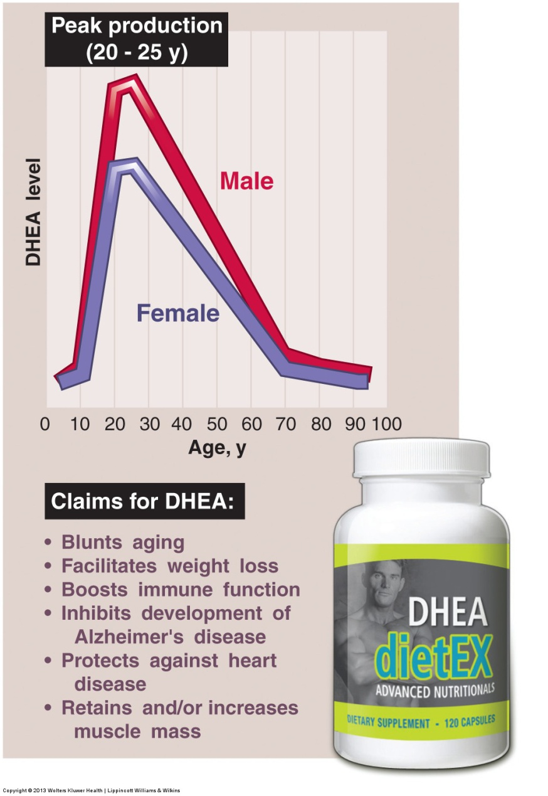
Notes:
Generalized trend for plasma levels of dehydroepiandrosterone (DHEA) for men and women during a lifetime.

Slide 14
Androstenedione
Benefits of use:
Directly stimulates testosterone production
enables athletes to train harder, build muscle mass, and repair injury more rapidly
Aids the liver in synthesizing other biologically active steroid hormones
Notes:
Because many countries consider androstenedione to be a controlled substance, individuals travel to the United States to purchase it.
Androstenedione is an intermediate or precursor hormone between DHEA and testosterone.

Slide 15
Amphetamines
Pep Pills
Stimulates the CNS by mimicking the actions of epinephrine and norepinephrine
Increased blood pressure, pulse rate , cardiac output, breathing rate, metabolism, and blood sugar
Increase alertness and wakefulness, but little or NO performance advantage exists
Notes:
The deaths of two famed cyclists in the 1960s during competitive road racing were attributed to amphetamine use for increased alertness and wakefulness and to augment work capacity.

Slide 16

Dangers of Amphetamines
Chronic use leads to physiologic or emotional drug dependency
General side effects:
Headache, agitation, insomnia, nausea, dizziness, and confusion
Prolonged intake of high doses produces:
Weight loss , paranoia, psychosis , repetitive compulsive behavior, and nerve damage
Notes:
Drug tolerance increases with prolonged use

Slide 17

Caffeine
Can be used as a drug, food, or dietary supplement
Belongs to a group of lipid soluble compounds called purines
Most widely consumed substance in the world
Benefits:
Extends endurance during
Strenuous exercise
Notes:
Caffeine belongs to a group of lipid-soluble compounds called purines found naturally in coffee beans, tea leaves, chocolate, cocoa beans, and cola nuts and often added to carbonated beverages and nonprescription medicines.

Slide 18
How Does Caffeine Act As An Ergogenic Aid?
Results from the facilitated use of fat as an exercise fuel
Spares limited glycogen reserves
Acts in either of 1 of 2 ways:
Directly on adipose and peripheral vascular tissues
Indirectly from stimulating epinephrine release by the adrenal medulla
Notes:
Increased levels of free fatty acids contribute to increased fat oxidation, thus conserving liver and muscle glycogen.
Sparing glycogen reserves benefits prolonged high-intensity exercise; diminished glycogen in active muscles coincides with reduced capacity to sustain a high rate of power output.

Slide 19
Warnings about Caffeine
Effects become less apparent when someone:
Consumes a high-carbohydrate diet
Uses caffeine habitually
Side effects of caffeine use (when consumed in quantities of 1.5 g or more daily):
Restlessness
Headaches
Insomnia and nervous irritability
Muscle twitching Elevated heart rate and blood pressure
Acts as a diuretic
Notes:
From the standpoint of temperature regulation, caffeine’s effect as a potent diuretic could cause unnecessary pre-exercise loss of fluid that negatively affects thermal balance and exercise performance in a hot environment.

Slide 20

Ginseng
Serves no recognized medical use in the US except as a soothing agent in skin ointments
A common claim is that Ginseng boosts energy and diminishes the negative effects of stress
No compelling scientific evidence exists that ginseng supplementation offers any ergogenic benefit for exercise performance
Notes:
At present, no compelling scientific evidence exists that ginseng supplementation offers any ergogenic benefit for physiologic function or exercise performance.

Slide 21
Ephedrine
FDA banned ephedrine in April 2004
Amphetamine-like alkaloid compound
Used to treat:
Asthma
Symptoms of the common cold
Hypotension
Urinary incontinence
CNS stimulant to treat depression
Notes:
Found in several species of the plant ephedra (dried plant stem called ma huang).

Slide 22
Ephedrine Side Effects
Increases heart rate, cardiac output, and BP
With high doses:
Hypertension
Insomnia
Hyperthermia
Cardiac arrhythmais
Other possible side effects include:
GI symptoms
Dizziness
Anxiety
Difficulty concentrating

Slide 23
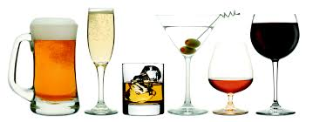
Alcohol
Ethyl alcohol or ethanol
Classified as a depressant drug
Alcohol is abused more than any other drug in the U.S.
Alcohol intake before competition may reduce tension and anxiety, enhance self-confidence, and promotes aggressiveness

Slide 24
Alcohol Side Effects
Produces generalized CNS depression
Impairs balance, hand-eye coordination, reaction time
Impairs cardiac function
Alcohol exaggerates the dehydrating effect
Research does not substantiate any ergogenic effect of alcohol on muscular strength, short-term anaerobic power, or longer term aerobic activities
Notes:
Alcohol blunts the liver’s capacity to synthesize glucose from noncarbohydrate sources via gluconeogenesis.
Alcohol provides no benefit as an energy substrate and does not favorably alter the metabolic mixture in endurance exercise.
Substituting alcohol for high-glycemic carbohydrates in the postexercise replenishment period decreases optimal glycogen storage in recovery.

Slide 25
Glutamine
A non-essential amino acid
Modulates glucose homeostasis during and after exercise
Facilitates post-exercise recovery
Promotes muscle glycogen accumulation
To date, research shows that glutamine supplementation in healthy young adults did not affect muscle performance, body composition, or muscle protein degradation compared with a placebo
Notes:
Glutamine plasma concentrations decrease following prolonged high-intensity exercise, so a glutamine deficiency has been linked to the immunosuppression caused by strenuous exercise.

Slide 26
Phosphatidylserine
A class of lipids that constitutes the structural components of biologic membranes
Might modify the response to stress
Soybean lecithin is the most common form PS for supplementation by athletes
The physiologic mechanism for any ergogenic effect remains unknown

Slide 27
ß-Hydroxy-ß-Methylbutyrate (HMB)
Generated from the breakdown of the essential branched-chain amino acid leucine
May decrease protein loss during stress by inhibiting protein catabolism
Increased fatty acid oxidation
The mechanism for HMB’s action on muscle metabolism, strength improvement, and body composition remains unknown
Notes:
Researchers speculate that this metabolite inhibits normal proteolytic processes that accompany intense muscular overload.
Not all research shows beneficial effects of HMB supplementation with resistance training.

Slide 28
Hormonal Blood Boosting
Some athletes use recombinant epoetin(EPO), a synthetic form of erythropoietin
Regulates red blood cell production within the marrow of the long bones
Can result in dangerously ↑ hematocrit levels
increases risk of stroke, heart attack, and heart failure
Notes:
The International Cycling Union has set a hematocrit threshold of 50% for males and 47% for females, while the International Skiing Federation uses a hemoglobin concentration of 18.5 g·dL⁻¹ as the disqualification threshold.

